Slide 1
Special Electors Meeting
Monday 17 June 2019

Slide 2
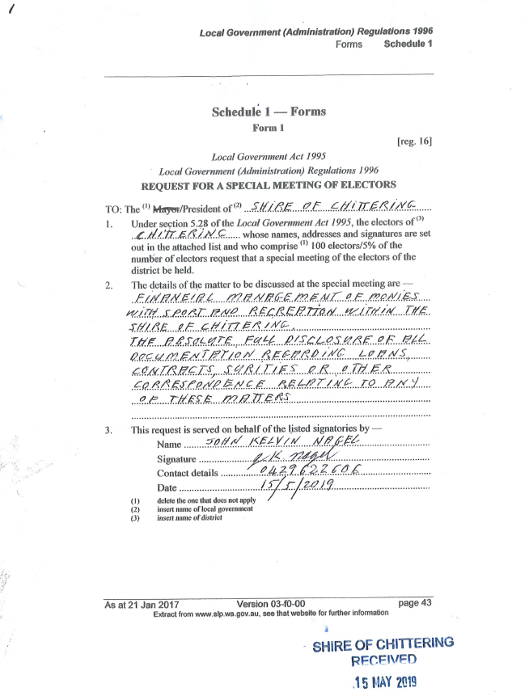
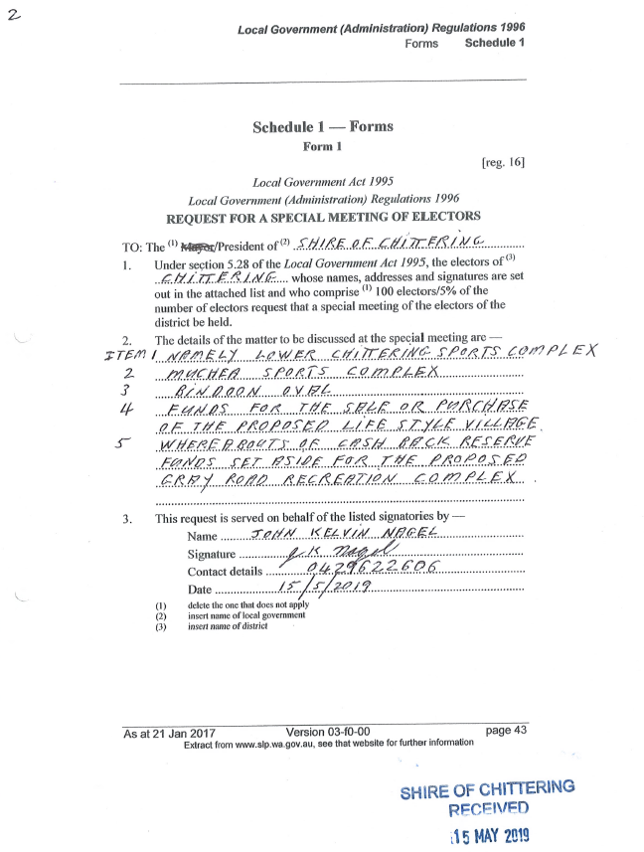
Request of Special Electors Meeting

Slide 3
Notice of Invitation

Slide 4
Matters to be discussed
Financial management of monies with sport and recreation within the Shire of Chittering.
The absolute full disclosure of all documentation regarding loans, contracts, sureties or other correspondence relating to any of these matters:
Lower Chittering Sports Complex
Muchea Sports Complex
Bindoon Oval
Funds for the sale or purchase of the proposed Life Style Village
Whereabouts of cash back reserve funds set aside for the proposed Gray Road Recreation Complex.
Further clarification was sought from Mr John Nagel on behalf of the signatories and in the presence of Mr Dennis Boyanich, by Shire CDC – Lisa Kay and Acting CEO, Neil Hartley on Tuesday 22 May 2019 in relation to the above matters, to ascertain what specific information was being sought for the above items.
More specifically:
Lower Chittering Sports Complex – contract between the Immaculate Heart College and the Shire of Chittering;
Muchea Sports Complex – general overview of Shire support to Muchea including plans and expenditure;
Bindoon Oval – the allocation of $80,000 for reticulation to Bindoon Oval;
Life Style Village – the $500,000 in a reserve for this project.
Gray Road Recreation Complex Reserve Funds – where has the money gone that was put into a reserve for this facility?
Note: This presentation, plus a number of supporting documents are all loaded onto the Shire’s Web Page under the title of “Electors Special Meeting – 17 June 2019”

Slide 5
Lower Chittering Sports Complex – contracts between the Immaculate Heart College and the Shire of Chittering
Two contracts proposed – (1) Loan Agreement; and (2) Land Sale Agreement;
Loan – $1.625m over 20 years;
The Loan will form part of the 2019/20 Budget process and be raised in three portions:
15 June 2020 $625,000
15 December 2020 $500,000
15 March 2021 $500,000

Slide 6
Immaculate Heart College Loan
OCM 17 October 2018 - 9.4.6 Lower Chittering Sports and Recreation Facility
That Council:
1. Note the significant progress which has been made towards the development an appropriately detailed and fully costed funding application with supporting technical and economic studies.
2. Authorise the Chief Executive Officer to negotiate a funding commitment from Immaculate Heart College as a contribution towards the capital cost of the project.
3. Authorise the Chief Executive Officer to obtain letters of support from Immaculate Heart College regarding the intention to enter into long term arrangements for the management and maintenance of such a facility.
5. Note that the Building Better Regions Fund (BBRF3) funding round was announced on 27 September 2018 and that applications are required to be lodged by 15 November 2018.
6. Authorise the Chief Executive Officer to lodge a funding application under the Building Better Regions Fund (BBRF3).

Slide 7
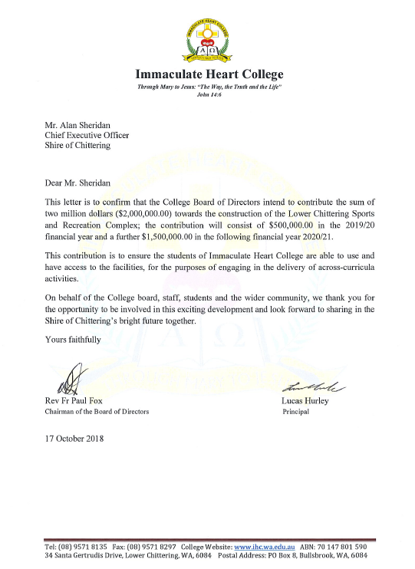
Loan Agreement
This original contribution commitment was included in the Building Better Regions Fund Application (Ref:O18101497) as a requirement to show stakeholder contributions.
In all instances of grant funding, once approval of the grant is announced and the grant is fully executed, the Shire finalises all other stakeholder contributions. The Shire has been finalising stakeholder contribution/s (IHC) to the Lower Chittering Sports Facility as evidenced through OCM Wednesday, 20 March 2019, OCM Wednesday 17 April 2019, OCM Wednesday 15 May 2019.
A copy of the entire Grant Application is on the Shire’s Web Page.

Slide 8
Immaculate Heart College Loan
OCM Wednesday March 2019 - 9.4.3 MOTION / COUNCIL RESOLUTION 260319
That Council:
10. Authorise the Chief Executive Officer to seek an agreement with Immaculate Heart College for its $2m contribution for Council’s consideration;
11. Authorises the Chief Executive Officer to commence the process of securing a (up to) $3m loan facility from WA Treasury;
Contracts – Still in draft format. Will be considered at the 19 June 2019 Council Meeting. Includes “Use” and “Operating Costs” clauses outlining school use rights/limitations, and operating costs contribution calculations and obligations.
Sureties – as per Loan Agreement only.
Copy of Council Resolutions, and Draft Loan Agreement are available on the Shire’s Web Page.

Slide 9
The land configuration, purchase, and sale
Part of a 10ha State Crown Reserve
Vested in Shire of Chittering
Reserve Purpose - Recreation
3ha purchased from State Government for 5% of value ($13,750 (+GST) = $15,125) for the purpose of sale to create funds to develop infrastructure
Sold to IHC for $275,000
Copy of Council Resolutions, Valuation, Crown Purchase Agreement, on Web.

Slide 10
Bindoon Retirement Village
Land was sold to Retirees WA in 2014 for $530,000;
Funds were allocated (OCM 20 August 2014 – 14.1 – Independent Living Units) Council resolved to use the sale funds for the development of the Lot 62 Koomal Street, with any balance used for Binda Place development;
Costs for 62 Koomal development ($195,032) and for Binda Place ($2,256,262 - $1,946,046 R2R Grant = $310,216). Total of $505,248;
Proposal did not come to fruition so land bought back under contract default clause (March 2019 - $502,500 – land price only);
Land Buy-Back cost ($502,500 + settlement/transfer costs) has been funded by way of a loan (2018/19 budget) – refer to (OCM 20 March 2019 – 14.1.1 – Portion of Lot 89: Repurchase Option Clause Take-up).
Copy of Council Resolutions, Business Plan and Sale Contract, on Web.

Slide 11
Bindoon Retirement Village
In regard to the question in regard to a $500,000 Lifestyle Village reserve fund. There is no specific reserve fund for a Lifestyle Village, but the Shire does have the following two reserves–
The Shire has a reserve fund titled Community Housing ($72,240 - to fund repairs, improvements, extensions or construction of community units) and a Senior Housing Reserve Account ($7,446 - to fund repairs, improvements, extensions or construction of seniors units).
Both these reserves are linked to the Shire’s Joint Venture Department of Housing projects and can only be used for those facilities (i.e. not a spate Lifestyle Village).

Slide 12
Bindoon Oval ($80,000 for Reticulation)
The Bindoon Oval Facility is listed in the Shire’s Corporate Business Plan 2017 – 2021 and its Long Term Financial Plan (2018 – 2028) - see Shire’s Website for a copy of this document;
In the Long Term Financial Plan, there are capital funding allocations for Bindoon Oval improvements, namely, Cricket Pitch resurface ($22,000); and numerous improvements for Chinkabee, including Gymnasium $160,000 ($100,000 grant/contribution); Chinkabee Masterplan $1m ($250,000 grant);
The day-to-day maintenance is largely carried out by the Shire’s operations staff, supplemented with contractors for specific works and professional trades, like plumbers and electricians;
There are no loans outstanding;
There are no fixed contracts in place;
There are no Surities in place or required.

Slide 13
Bindoon Oval
There is a certain amount of complexity to the management of the Bindoon Oval as the oval is managed separately by the Shire whilst being positioned amongst the Chinkabee Complex (managed by Bindoon Sport & Recreation Association), Bindoon Town Hall (managed by Bindoon Entertainment Arts and Theatre - BEAT) and Bindoon Post Office (managed by the Chittering Tourist Association) including the tourist park hard stand surrounding the oval.
In regard to the particular question about the $80,000 apparently spent on reticulation –
No record exists of reticulation being installed at the this oval in the last several years; nor are there any proposed plans in the corporate Business Plan or the Long Term Financial Plan.
There is no record of a specific item that relates to $80,000 reticulation for the Bindoon Oval either in past expenditure or future shire plans. There has however been several smaller projects and maintenance items undertaken at the Bindoon Oval.
The only reticulation based projects that have been earmarked are:
Sandown Park in Muchea for (Shire of Chittering Sport and Recreation Plan 2012 – 2022.) Identified in the Corporate Business plan but not the LTFP.
Muchea Contribution Muchea Oval Reticulation/Lighting 2021-22 ($150,000) includes $50,000 contribution and $50,000 grants. Identified in LTFP but not Corporate Business Plan.

Slide 14
Gray Road Recreation Complex
March 2002 OCM - Council resolved to establish a Sport & Recreation Steering Committee to undertake a Recreation Study for the Shire of Chittering.
OCM 19 December 2002 - Recreation Development, Bindoon
Council resolved to:
Prepare concept plans for recreation development opportunities on Lot 979 Bindoon Townsite and Lot 104 Gray Road by 31 January 2003
Convene a community workshop in February 2003 to consider the concept plans and any other proposals
Prepare a development plan based on the outcomes of the community workshop.
Prepare cost estimates for the components of the development for consideration in the 2003/04 and future budgets.

Slide 15
Gray Road Recreation Complex
September 2003 OCM Council resolved to lay on the table pending a Council workshop “Adopt the Sport & Recreation Plan, Report and Sport and Recreation Implementation Plan for the Shire of Chittering”.
Developed by Shire of Chittering Sport and Recreation Development Plan Steering Committee, in consultation with consultant Creating Communities, the Steering Committee identified the following priorities:
That Council undertakes the consolidation of a multi-functional community facility at the Chinkabee Complex in Bindoon and vigorously pursues the concept of a community hub. The facility should cater for not only indoor and outdoor sport and recreation activities but include a broad range of other community services and programs.
That Council undertakes to develop the public open space acquired on Gray Road for the purposes of active recreation and sport.
That preliminary planning for community hubs including sport and recreation facilities at the proposed New Town occurs at the initial stages and becomes an integral part of the sport and recreation plan. Due consideration should be given to ensure facilities proposed for New Town and other communities complement each other rather than compete.
That the development of outdoor recreation opportunities, especially trails becomes an important focus of sport and recreation development and is given appropriate resources to ensure its viability.
That multi-functional, flexible and shared use facilities projects be given priority support in preference to “stand alone” single use facilities.

Slide 16
Gray Road Recreation Complex
Shire Staff have inspected Council minutes and records management system files pertaining to the Gray Road Recreational Ground and the Lower Chittering Sports Facility from 2002 – 2008 and have not found any further items that relate to these projects until the 2012-2022 Sport and Recreation Plan. It appears that the draft Sport & Recreation Plan, Report and Sport and Recreation Implementation Plan tabled at the September 2003 OCM was not ratified by Council, however the basis of information appears to have been incorporated into the Shire of Chittering 2012-2022 Sport and Recreation Plan.

Slide 17
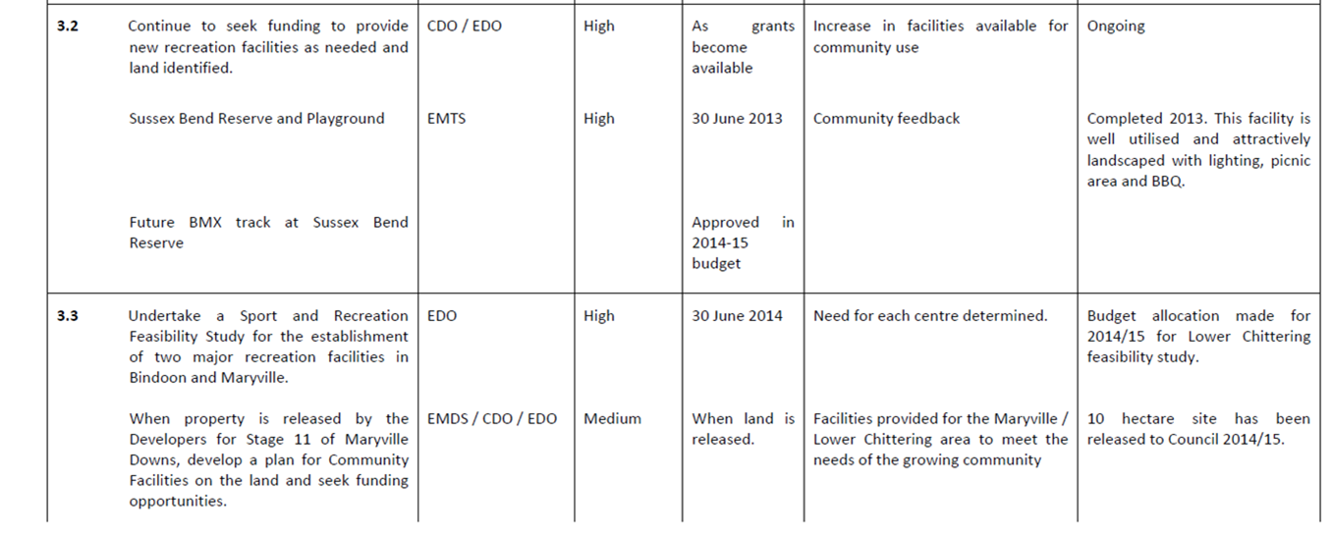
Gray Road Recreation Complex
Sport & Recreation Action Plan 2012 - 2022
1.8 - Bindoon – investigate the potential of the Gray Road property for use and expanding of the current facilities. Investigate other options.
By 30 June 2015 – Identify the need for a feasibility study; If supported undertake study; community consultation; prepare plans and apply for funding.
Grey Road Recreation Complex.
The 2012-2022 Sport and Recreation Plan is available on the Shire’s Web Page.

Slide 18
Gray Road Recreation Complex
Shire of Chittering Long Term Financial Plan 2013-2028
Gray Road Recreation Complex
No allocation within the current LTFP

Slide 19
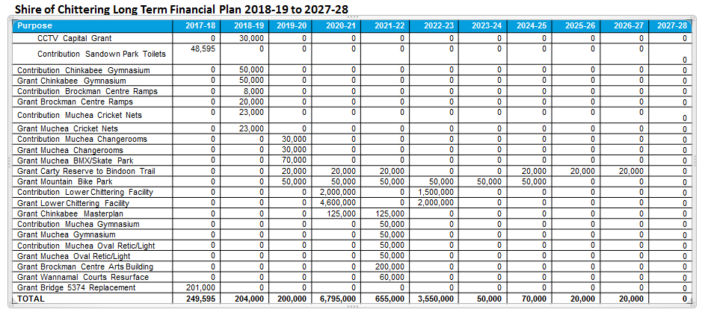
Gray Road – deleted from to 2018-2028 LTFP
In the transition from one plan to the next Shire staff liaise with the respective Facility Managers and respective clubs to determine if the priority remains for the listed project. In some instances projects are removed from the plan due to changing circumstances such as, the club is no longer viable (as is the case with the Chittering Riding Club) or changing priorities that require urgent attention (Muchea ATU upgrade replaced Changeroom renovation)
Bindoon Bypass
Water
Depot Site option
Still possible, but no funds allocated.
Chinkabee Master Plan
Lower Chittering Facility

Slide 20
Gray Road Recreation Complex (Reserve Funds)
More specifically the whereabouts of cash back reserve funds set aside for the proposed Gray Road Recreation Complex
There is no reference listed for a Gray Road Recreation Complex in the Shire’s Corporate Business Plan 2017 – 2021 or its Long Term Financial Plan (2018 – 2028) - see Shire’s Website for a copy of these documents;
The Shire has several reserve fund accounts (e.g. Plant Replacement; Community Housing; etc) and the total Reserve Funds balance at 30 June 2018 was $2,094,181;
Whilst there are two reserves, Public Open Space ($270,746) for Public Open Space development) and Recreation Development ($233,351) to develop or acquire land and facilities). There is no specific reserve fund for the Gray Road Recreation Complex, its funding would come from either/both of the above more general reserve account;
There is a Loan Outstanding the Gray Road Land Acquisition ($62,082 @ 30 June 2018).

Slide 21
Muchea Sports Complex - plans and expenditure
The Muchea Hall Facility is listed in the Shire’s Corporate Business Plan 2017 – 2021 and its Long Term Financial Plan (2018 – 2028) - see Shire’s Website for a copy of this document;
In the Long Term Financial Plan, there are numerous minor funding allocations for Muchea Hall improvements, including Cricket Nets $67,000 ($23,000 grant), Change-rooms $100,000 ($60,000 grant/contributions), Reticulation/Lighting $150,000 ($100,000 grant/contributions), Gymnasium $160,000 ($100,000 grant/contribution), resurface Netball Courts ($40,875 + $30,000); Entrance Sign ($20,000), Hall air-conditioning/CCTV ($38,500);
The day-to-day maintenance is largely carried out by the Shire’s operations staff, supplemented with contractors for specific works and professional trades, like plumbers and electricians;
Loans – There are no loans relevant to the Muchea Hall Facility;
Contracts – There are several contracts relevant to the maintenance and operations of the Facility (vis. multi year cleaning contract; electrical; and plumbing);
Sureties – There are no sureties relevant.

Slide 22
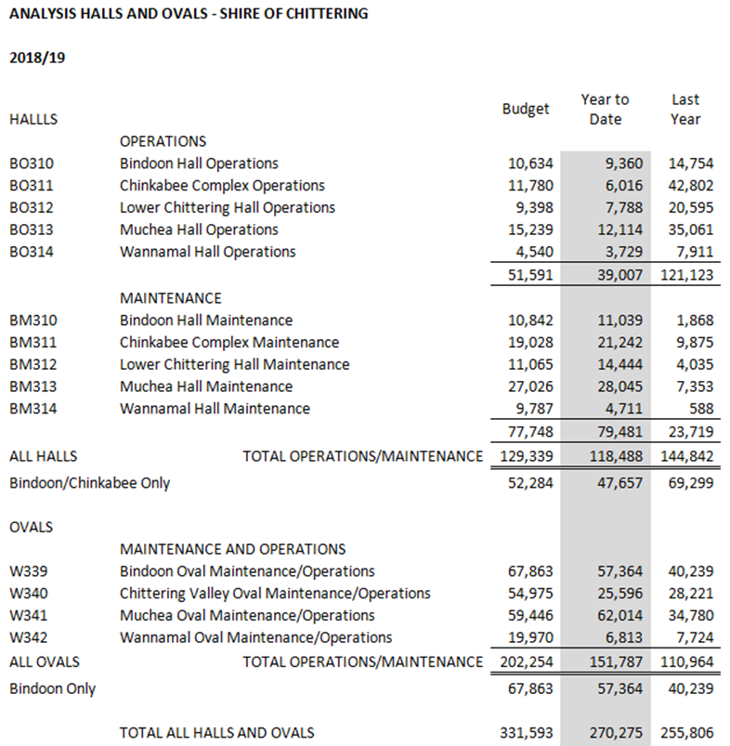
Muchea Sports complex
Operational and Maintenance cost for Halls and ovals 2018/2019:

Slide 23
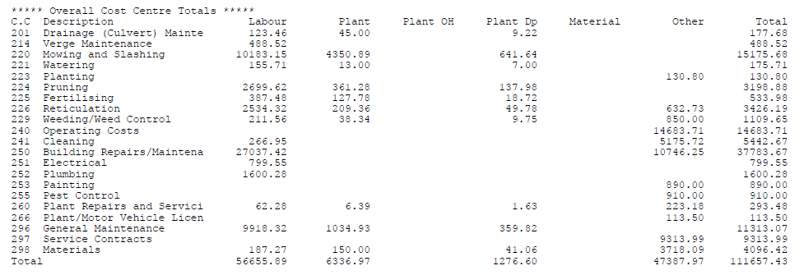
Muchea Hall & Oval (capital projects, building maintenance, building operations and oval accounts 2014 - 2019)
2014/2015
Total Expenditure: $111,657

Slide 24
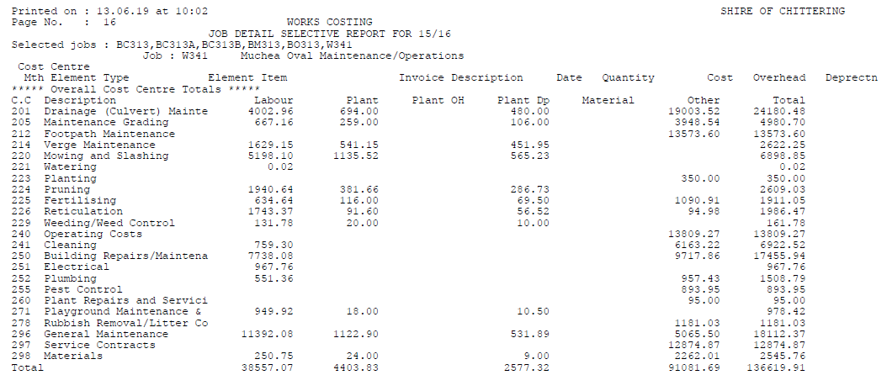
Muchea Hall & Oval (capital projects, building maintenance, building operations and oval accounts 2014 - 2019)
2015/2016
Total Expenditure: $136,620

Slide 25
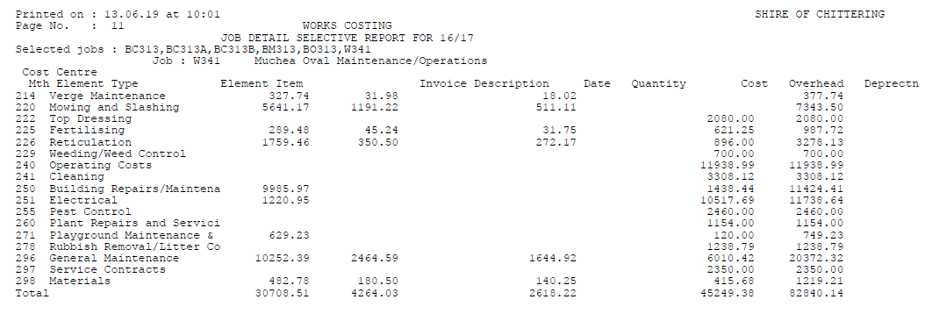
Muchea Hall & Oval (capital projects, building maintenance, building operations and oval accounts 2014 - 2019)
2016/2017
Total Expenditure: $82,840

Slide 26
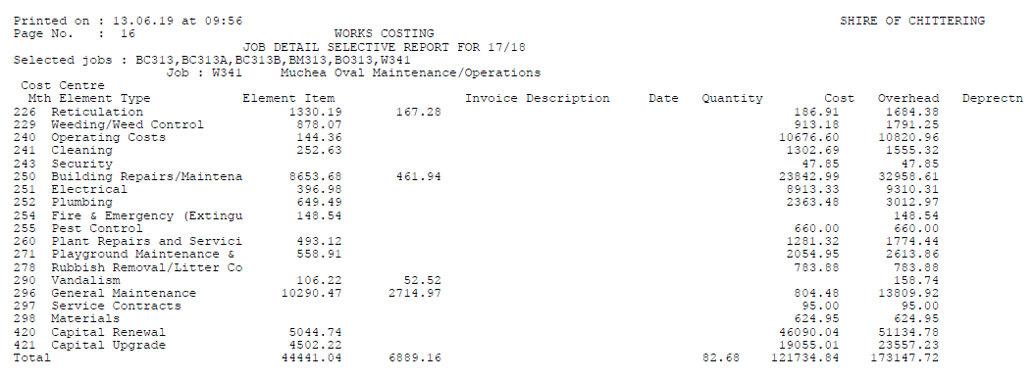
Muchea Hall & Oval (capital projects, building maintenance, building operations and oval accounts 2014 - 2019)
2017/2018
Total Expenditure: $173,147

Slide 27
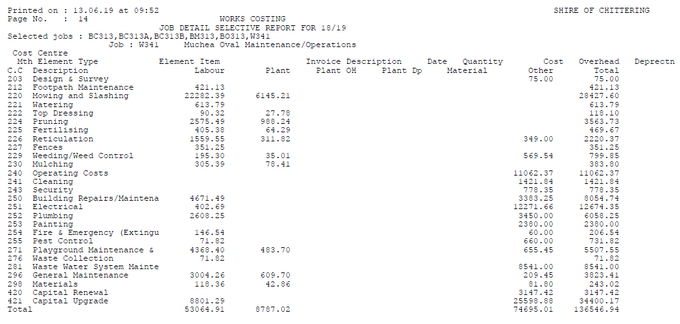
Muchea Hall & Oval (capital projects, building maintenance, building operations and oval accounts 2014 - 2019)
2018/2019
Total Expenditure: $136,547

Slide 28
Internal Control Document for Annual Recreation Budgets
The below document is an internal Shire document that tracks the projects undertaken as part of the Shire of Chittering Sport and Recreation Plan 2012 – 2022 and is read in conjunction with the Shire of Chittering 10 Year Building Maintenance Plan (current version 2019 – 2029)
In the most part, any grants pertaining to sporting facilities are funded either directly by the Shire, in partnership with the facility users and/or as part of a CSRFF small grant through the Department of Local Government, Sport and Cultural Industries as a 3 way partnership. In many instances club contributions have been through in-kind voluntary contributions or through Club Sponsors.

Slide 29
Internal Control Document for Annual Recreation Budgets

Slide 30
Internal Control Document for Annual Recreation Budgets

Slide 31
Internal Control Document for Annual Recreation Budgets

Slide 32
Internal Control Document for Annual Recreation Budgets

Slide 33
Internal Control Document for Annual Recreation Budgets

Slide 34
Internal Control Document for Annual Recreation Budgets

Slide 35
Is there something else you would like covered as part of tonight’s presentation?

